Slide 1
REPUBLIC ACT NO. 6713
AND OTHER LAWS
ATTY. CRISTINA JENNY R. CARIÑ0, CPA
PUBLIC ATTORNEY’S OFFICE
REGIONAL OFFICE NO. 1

Slide 2
REPUBLIC ACT NO. 6713
This Act shall be known as the “Code of Conduct and Ethical Standards for Public Officials and Employees”
It was signed into law on February 20, 1989
It took effect on March 25, 1989.

Slide 3
DECLARATION OF POLICIES
It is the policy of the State to promote a high standard of ethics in the public service.
Public officials and employees shall at all times be accountable to the people and shall discharge their duties with utmost responsibility, integrity, competence, loyalty, act with patriotism and justice, lead modest lives, and uphold public interest over personal interest.
Notes:
SECTION 2, RA 6713

Slide 4
PUBLIC OFFICIALS
Includes:
  Elective and appointive officials and employees,
  Permanent or temporary,
  Whether in the career or non-career service,
  Including military and police personnel, whether or not they receive compensation, regardless of amount.
Notes:
SEC. 3(b), RA 6713

Slide 5
NORMS OF CONDUCT OF PUBLIC OFFICIALS AND EMPLOYEES
Commitment to public interest
Professionalism
Justness and sincerity
Political neutrality
Responsiveness to the public
Nationalism and patriotism
Commitment to democracy
Simple living
Notes:
SEC. 4, RA 6713

Slide 6
COMMITMENT TO PUBLIC INTEREST
Public officials and employees shall always uphold the public interest over and above personal interest.
All government resources and powers of their respective offices must be employed and used efficiently, effectively, honestly and economically, particularly to avoid wastage in public funds and revenues.

Slide 7
PROFESSIONALISM
Public officials and employees shall perform and discharge their duties with the highest degree of excellence, professionalism, intelligence and skill.
They shall enter public service with utmost devotion and dedication to duty.
They shall endeavor to discourage wrong perceptions of their roles as dispensers or peddlers of undue patronage.

Slide 8
HUWAG BALAT SIBUYAS
A public official, more especially an elected one, should not be onion skinned.
Strict personal discipline is expected of an occupant of a public office because a public official is a property of the public.
He is looked upon to set the example how public officials should correctly conduct themselves even in the face of extreme provocation.
Always he is expected to act and serve with the highest degree of responsibility, integrity, loyalty and efficiency and shall remain accountable for his conduct to the people. (Yabut vs. Ombudsman, June 17, 1994)

Slide 9
JUSTNESS AND SINCERITY
Public officials and employees shall remain true to the people at all times.
They must act with justness and sincerity and shall not discriminate against anyone, especially the poor and the underprivileged.

Slide 10
JUSTNESS AND SINCERITY
They shall at all times respect the rights of others, and shall refrain from doing acts contrary to law, good morals, good customs, public policy, public order, public safety and public interest.

Slide 11
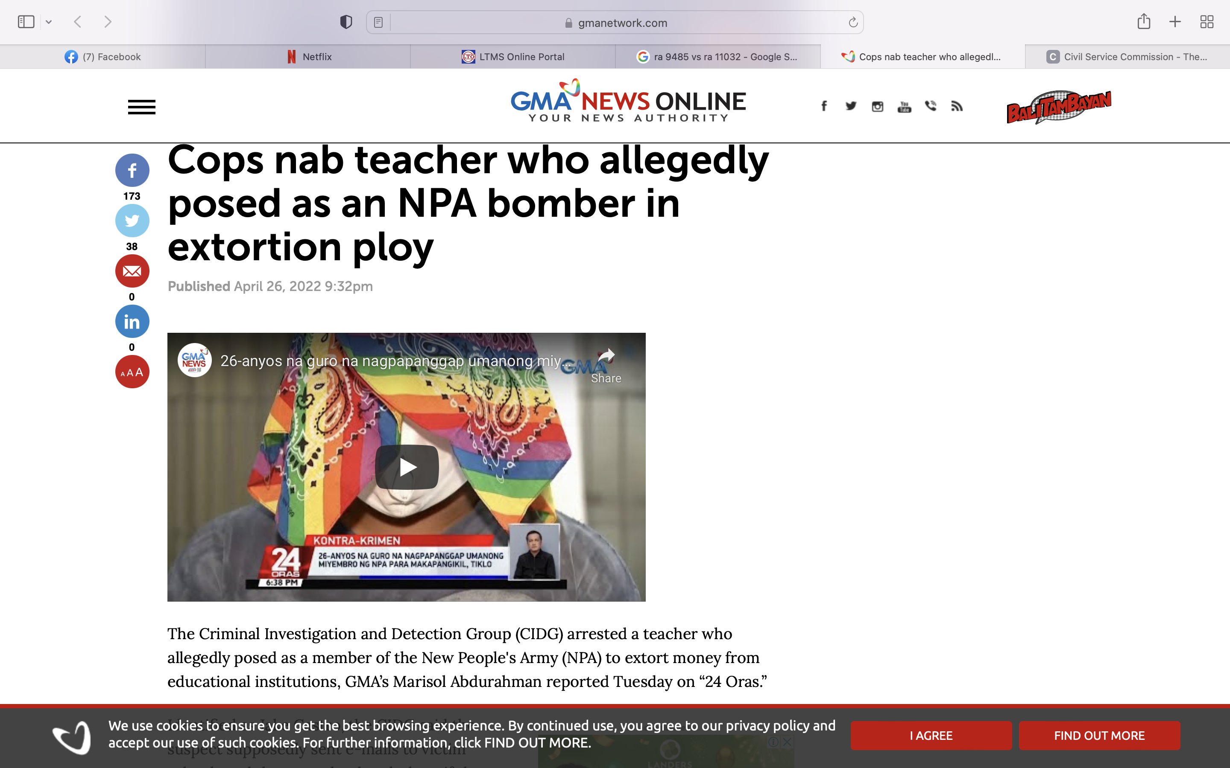
ACT
CONTRARY
TO LAW
Notes:
Source: GMA news online

Slide 12
ACT
CONTRARY
TO LAW
Identified as Jake Castro, the CIDG said the suspect supposedly sent e-mails to victim schools and threatened to bomb them if they did not pay him P2 million in cash.
At least 114 schools in Metro Manila had received the said e-mail in just two days.
A school principal sought help from authorities, and undercover policemen who pretended to be school staff caught the suspect in an entrapment operation.
Aside from the boodle money, also recovered from the suspect was a .38 caliber gun.
Notes:
Source: GMA news online

Slide 13
JUSTNESS AND SINCERITY
They shall not dispense or extend undue favors on account of their office to their relatives whether by consanguinity or affinity except with respect to appointments of such relatives to positions considered strictly confidential or as members of their personal staff whose terms are coterminous with theirs.

Slide 14
POLITICAL NEUTRALITY
Public officials and employees shall provide service to everyone without unfair discrimination and regardless of party affiliation or preference.

Slide 15
RESPONSIVENESS TO THE PUBLIC
Public and employees shall extend prompt, courteous, and adequate service to the public.
Unless otherwise provided by law or when required by the public interest, public officials and employees shall:
  provide information of their policies and procedures in clear and understandable language,
  ensure openness of information, public consultations and hearings whenever appropriate,
  encourage suggestions,
  simplify and systematize policy, rules and procedures,
  avoid red tape and
  develop an understanding and appreciation of the socio-economic conditions prevailing in the country, especially in the depressed rural and urban areas.

Slide 16
REPUBLIC ACT NO. 9485
The Anti-Red Tape Act of 2007 was enacted into law to improve efficiency in the delivery of government services to the public by reducing bureaucratic red tape, preventing graft and corruption.

Slide 17
RED TAPE
An idiom that refers to excessive regulation or rigid conformity to formal rules that is considered redundant or bureaucratic and hinders or prevents action or decision-making.

Slide 18
REPUBLIC ACT NO. 9485
Sec. 12. Criminal Liability for Fixers.
Imprisonment not exceeding six (6) years
or a fine not less than P20,000.00 but not more than P200,000.00
or both fine and imprisonment at the discretion of the court

Slide 19
REPUBLIC ACT NO. 11032
The Ease of Doing Business and Efficient Government Service Delivery Act of 2018
Signed into law on May 28, 2018, the law effectively amends RA 9485 or the Anti-Red Tape Act of 2007.
It is an act that aims to streamline the current systems and procedures of government services
This particular agenda pertains to improving the competitiveness of and ease of doing business in the Philippines.

Slide 20
REPUBLIC ACT NO. 11032
Violations of RA No. 11032 or the Ease of Doing Business and Efficient Government Service Delivery Act of 2018 are considered administrative offenses.
In Resolution No. 2000222, the CSC amended the 2017 Rules on Administrative Cases in the Civil Service (RACCS) to be consistent with the provisions of R.A. No. 11032.
Said resolution was published on 10 December 2021 and took effect fifteen (15) days after.

Slide 21
VIOLATIONS AND PERSONS LIABLE
Sec. 21. Violations and Persons Liable. – Any person who performs or cause the performance of the following acts shall be liable:
Refusal to accept application or request with complete requirements being submitted by an applicant or requesting party without due cause;
Imposition of additional requirements other than those listed in the Citizen’s Charter;
Notes:
SEC. 21, RA 11032

Slide 22
VIOLATIONS AND PERSONS LIABLE
Imposition of additional costs not reflected in the Citizen’s Charter;
Failure to give the applicant or requesting party a written notice on the disapproval of an application or request;
Failure to render government services within the prescribed processing time on any application or request without due cause;
Notes:
SEC. 21, RA 11032

Slide 23
VIOLATIONS AND PERSONS LIABLE
Failure to attend to applicants or requesting parties who are within the premises of the office or agency concerned prior to the end of official working hours and during lunch break;
Failure or refusal to issue official receipts; and
Fixing and/or collusion with fixers in consideration of economic and/or other gain or advantage.
Notes:
SEC. 21, RA 11032

Slide 24
PENALTIES AND LIABILITIES
SEC. 22. Penalties and Liabilities. – Any violations of the preceding actions will warrant the following penalties and liabilities:
First offense: Administrative liability with six (6) months suspension: Provided, however, That in the case of fixing and/or collusion with fixers under Section 21 (h), the penalty and liability under Sec. 22 (b) of this Act shall apply.
Notes:
SEC. 22, RA 11032

Slide 25
PENALTIES AND LIABILITIES
Second offense: Administrative liability and criminal liability of dismissal from the service, perpetual disqualification from holding public office and forfeiture of retirement benefits and imprisonment of one (1) year to six (6) years with a fine of not less than Five hundred thousand pesos (P500,000.00), but not more than Two million pesos (P2,000,000.00).
Notes:
SEC. 22, RA 11032

Slide 26
PENALTIES AND LIABILITIES
Criminal liability shall also be incurred through the commission of bribery, extortion, or when the violation was done deliberately and maliciously to solicit favor in cash or in kind. In such cases, the pertinent provisions of the Revised Penal Code and other special laws shall apply.
Notes:
SEC. 22, RA 11032

Slide 27
THE ANTI-RED TAPE AUTHORITY
Section 17 of R.A. No. 11032 provides for the creation of the Anti-Red Tape Authority or ARTA.
The government agency mandated to administer and implement the law and regulations, and
to monitor and ensure compliance with the national policy on anti-red tape and ease of doing business in the country.

Slide 28
NATIONALISM AND PATRIOTISM
Public officials and employees shall at all times be loyal to the Republic and to the Filipino people,
promote the use of locally produced goods, resources and technology and
encourage appreciation and pride of country and people.
They shall endeavor to maintain and defend Philippine sovereignty against foreign intrusion.

Slide 29
COMMITMENT TO DEMOCRACY
Public officials and employees shall commit themselves to the democratic way of life and values,
maintain the principle of public accountability, and manifest by deeds the supremacy of civilian authority over the military.
They shall at all times uphold the Constitution and put loyalty to country above loyalty to persons or party.

Slide 30
SIMPLE LIVING
Public officials and employees and their families shall lead modest lives appropriate to their positions and income.
They shall not indulge in extravagant or ostentatious display of wealth in any form.

Slide 31
SIMPLE LIVING
Basically, modest and simple living means maintaining a standard of living within the public official or employee’s visible means of income as correctly disclosed in his income tax returns, annual statement of assets, liabilities and net worth and other documents relating to financial and business interests and connections.

Slide 32
DUTIES OF PUBLIC OFFICIALS AND EMPLOYEES
Act promptly on letters and requests
Submit annual performance reports
Process documents and papers expeditiously
Act immediately on the public’s personal transactions
Make documents accessible to the public
Notes:
SEC. 5, RA 6713

Slide 33
ACT PROMPTLY ON LETTERS AND REQUESTS
All public officials and employees shall, within fifteen (15) working days from receipt thereof, respond to letters, telegrams or other means of communications sent by the public.
The reply must contain the action taken on the request.

Slide 34
SUBMIT ANNUAL PERFORMANCE REPORTS
All heads or other responsible officers of offices and agencies of the government and of government-owned or controlled corporations shall, within forty-five (45) working days from the end of the year, render a performance report of the agency or office or corporation concerned.
Such report shall be open and available to the public within regular office hours.

Slide 35
PROCESS DOCUMENTS AND
PAPERS EXPEDITIOUSLY
All papers and documents must be processed and completed within a reasonable time from the preparation thereof and must contain, as far as practicable, not more than three (3) signatories therein.
In the absence of duly authorized signatories, the official next-in-rank or officer-in-charge shall sign for and in their behalf.

Slide 36
ACT IMMEDIATELY ON THE PUBLIC’S PERSONAL TRANSACTIONS
All public officials and employees must attend to anyone who wants to avail himself of the services of their offices and must, at all times, act promptly and expeditiously.

Slide 37
MAKE DOCUMENTS ACCESSIBLE TO THE PUBLIC
All public documents must be made accessible to, and readily available for inspection by, the public within reasonable working hours.

Slide 38
TRANSPARENCY OF TRANSACTION
AND ACCESS TO INFORMATION
Every department, office or agency shall provide official information, records or documents to any requesting public, except if:
  such information, record or document must be kept secret in the interest of national defense or security or the conduct of foreign affairs;
  such disclosure would put the life and safety of an individual in imminent danger;
  the information, record or document sought falls within the concepts of established privilege or recognized exceptions as may be provided by law or settled policy or jurisprudence;
Notes:
SEC. 3 RULE IV, IRR OF RA 6713

Slide 39
TRANSPARENCY OF TRANSACTION
AND ACCESS TO INFORMATION
  such information, record or document comprises drafts of decisions, orders, rulings, policy decisions, memoranda, etc.;
  It would disclose information of a personal nature where disclosure would constitute a clearly unwarranted invasion of personal privacy;
Notes:
SEC. 3 RULE IV, IRR OF RA 6713

Slide 40
TRANSPARENCY OF TRANSACTION
AND ACCESS TO INFORMATION
  It would disclose investigatory records compiled for law enforcement purposes or information which if written would be contained in such records, but only to the extent that the production of such records or information would (i) interfere with enforcement proceedings, (ii) deprive a person of a right to a fair trial or an impartial adjudication, (iii) disclose the identity of a confidential source and in the case of a record compiled by a criminal investigation, or by an agency conducting a lawful national security intelligence investigation, confidential information furnished only by the confidential source, or (iv) unjustifiably disclose investigative techniques and procedures; or
Notes:
SEC. 3 RULE IV, IRR OF RA 6713

Slide 41
TRANSPARENCY OF TRANSACTION
AND ACCESS TO INFORMATION
  It would disclose information the premature disclosure of which would (i) in the case of a department, office or agency which agency regulates currencies, securities, commodities, or financial institutions, be likely to lead to significant financial speculation in currencies, securities, or commodities, or significantly endanger the stability of any financial institution; or (ii) in the case of any department, office or agency be likely or significantly to frustrate implementation of a proposed official action, except that subparagraph (f) )ii) shall not apply in any instance where the department, office or agency has already disclosed to the public the content or nature of its proposed action, or where the department, office or agency is required by law to make such disclosure on its own initiative prior to taking final official action on such proposal.
Notes:
SEC. 3 RULE IV, IRR OF RA 6713

Slide 42
SYSTEM OF INCENTIVES AND REWARDS
A system of annual incentives and rewards is hereby established in order to motivate and inspire public servants to uphold the highest standards of ethics.
a Committee on Awards to Outstanding Public Officials and Employees is hereby created composed of the following: the Ombudsman and Chairman of the CSC as Co-Chairmen, and the Chairman of the COA, and two government employees to be appointed by the President, as members.
Notes:
SEC. 6, RA 6713

Slide 43
CRITERIA IN THE CONFERMENT OF AWARDS
  Years of service;
  Quality and consistency of performance;
  Obscurity of the position;
  Level of salary;
  Unique and exemplary quality of achievement;
  Risk or temptation inherent in the work; and
  Any similar circumstances or considerations in favor of the particular awardee

Slide 44
SYSTEM OF INCENTIVES AND REWARDS
Incentives and rewards to government officials and employees of the year to be announced in public ceremonies honoring them may take the form of bonuses, citations, directorships in GOCCs, local and foreign scholarship grants, paid vacations and the like.
They shall likewise be automatically promoted to the next higher position with the commensurate salary suitable to their qualifications.
In case there is no next higher position or it is not vacant, said position shall be included in the budget of the office in the next General Appropriations Act.

Slide 45
PROHIBITED ACTS AND TRANSACTIONS
Financial and material interest - Public officials and employees shall not, directly or indirectly, have any financial or material interest in any transaction requiring the approval of their office.
Financial and material interest is defined as a pecuniary or proprietary interest by which a person will gain or lose something.
Notes:
SEC. 7, RA 6713

Slide 46
PROHIBITED ACTS AND TRANSACTIONS
Outside employment and other activities related thereto - Public officials and employees during their incumbency shall not:
  Own, control, manage or accept employment as officer, employee, consultant, counsel, broker, agent, trustee or nominee in any private enterprise regulated, supervised or licensed by their office unless expressly allowed by law;
  Engage in the private practice of their profession unless authorized by the Constitution or law provided, that such practice will not conflict or tend to conflict with their official functions; or

Slide 47
PROHIBITED ACTS AND TRANSACTIONS
  Recommend any person to any position in a private enterprise which has a regular or pending official transaction with their office, unless such recommendation or referral is mandated by (1) law, or (2) international agreements, commitment and obligation, or as part of the functions of his office.

Slide 48
OUTSIDE EMPLOYMENT AND OTHER ACTIVITIES RELATED THERETO
These prohibitions shall continue to apply for a period of one (1) year after resignation, retirement, or separation from public office, except in the case of subparagraph (b) (2) above, but the professional concerned cannot practice his profession in connection with any matter before the office he used to be with, in which case the one-year prohibition shall likewise apply.

Slide 49
PROHIBITED ACTS AND TRANSACTIONS
c) Disclosure and/or misuse of confidential information - Public officials and employees shall not use or divulge, confidential or classified information officially known to them by reason of their office and not made available to the public, to further their private interests, or give undue advantage to anyone, or to prejudice the public interest.

Slide 50
PROHIBITED ACTS AND TRANSACTIONS
d) Solicitation or acceptance of gifts - Public officials and employees shall not solicit or accept, directly or indirectly, any gift, gratuity, favor, entertainment, loan or anything of monetary value from any person in the course of their official duties or in connection with any operation being regulated by, or any transaction which may be affected by the functions of their office.

Slide 51
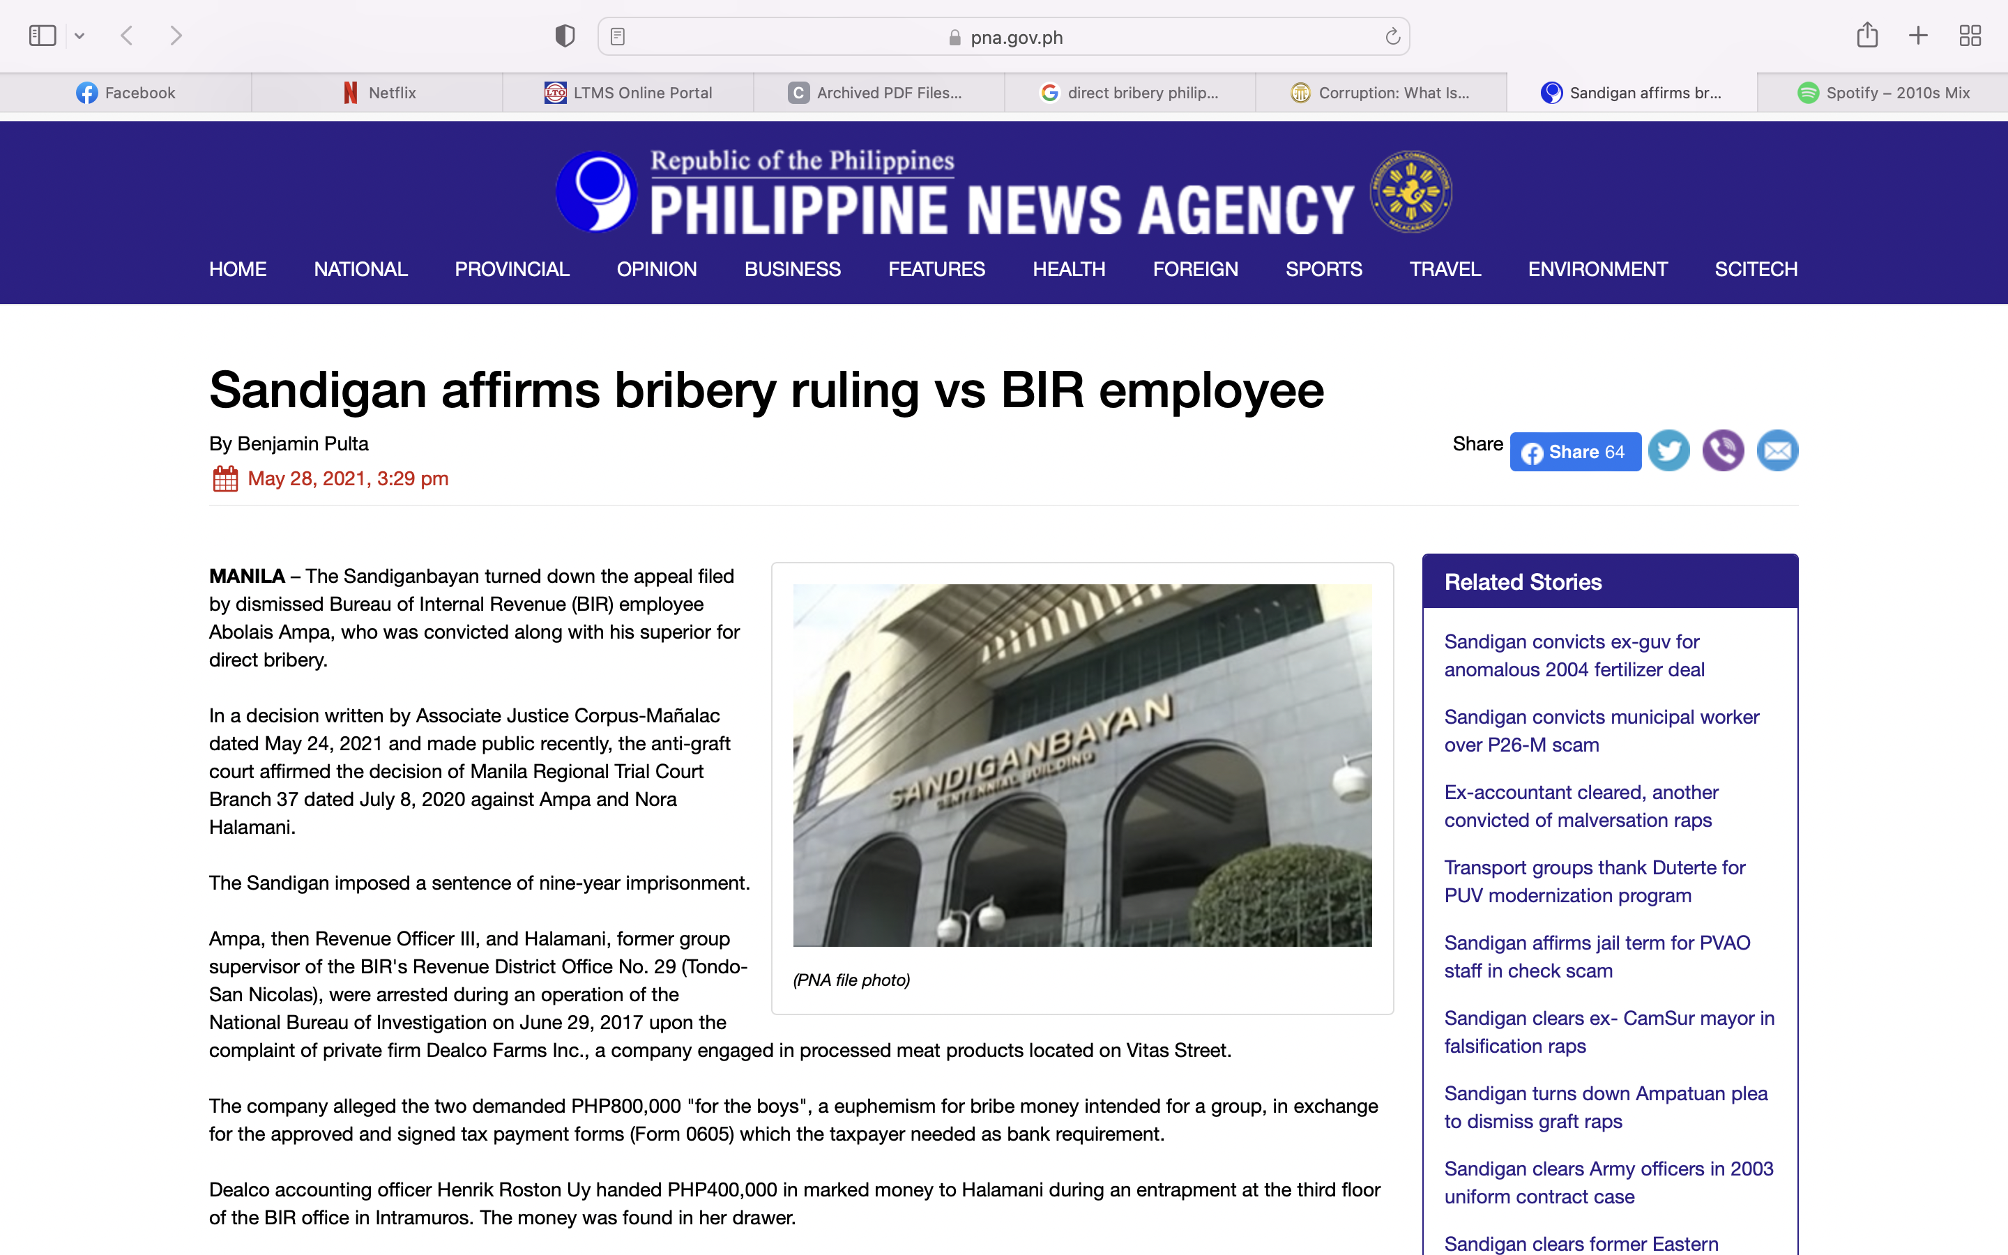
DIRECT BRIBERY AND VIOLATION OF SEC. 7 (d) OF RA NO. 6713

Slide 52
DIRECT BRIBERY AND VIOLATION OF SEC. 7 (d) OF RA NO. 6713
In 2017, the Ombudsman ordered the filing of charges against Ampa and Halamani for direct bribery and violation of Section 7 (d) of Republic Act No. 6713 (Code of Conduct and Ethical Standards for Public Officials and Employees) that states "public officials and employees shall not solicit or accept, directly or indirectly, any gift, gratuity, favor, entertainment, loan or anything of monetary value from any person in the course of their official duties".
Ampa, who denied the allegations, appealed the conviction by the Manila court but admitted texting the firm's officials to remind them of a three-year prescriptive period of assessment.
The Court of Appeals previously sustained Ampa’s dismissal by the Ombudsman, disregarding his appeal to give due consideration to his unblemished record during his 21 years of service.
“Indeed, length of service and a previously clean employment record cannot simply erase the gravity of the offense exhibited by a malfeasant employee. Length of service is not a bargaining chip that can simply be stacked against the employer,” the 2018 decision penned by Associate Justice Celia Librea-Leagogo read. (PNA)
Notes:
Source: Philippine News Agency

Slide 53
PROHIBITED ACTS AND TRANSACTIONS
The propriety or impropriety of the foregoing shall be determined by its value, kinship or relationship between the giver and receiver and the motivation.
A thing of monetary value is one which is evidently or manifestly excessive by its very nature.

Slide 54
GIFT
Refers to a thing or a right disposed of gratuitously, or any act or liberality, in favor of another who accepts it, and shall include a simulated sale or an ostensibly onerous disposition thereof.
Notes:
SEC. 3(c), RA 6713

Slide 55
LOAN
Covers both simple loan and commodatum as well as guarantees, financing arrangements or accommodations intended to ensure its approval.
Commodatum refers to a contract whereby one of the parties delivers to another something not consumable so that the latter may use the same for a certain time and return it.
Notes:
SEC. 3(e), RA 6713

Slide 56
THIS PROHIBITION SHALL NOT INCLUDE:
unsolicited gift of nominal or insignificant value not given in anticipation of, or in exchange for, a favor from a public official or employee or given after the transaction is completed, or service is rendered. As to what is a gift of nominal value will depend on the circumstances of each case taking into account the salary of the official or employee, the frequency or infrequency of the giving, the expectation of benefits, and other similar factors.
Notes:
SEC. 1 (f), RULE X OF IRR OF RA 6713

Slide 57
THIS PROHIBITION SHALL NOT INCLUDE:
A gift from a member of his family or relative on the occasion of a family celebration, and without any expectation of pecuniary gain or benefit.
Relatives – refers to any and all persons related to a public official or employee within the fourth civil degree of consanguinity or affinity, including bilas, inso and balae.
Notes:
SEC. 1 (f), RULE X OF IRR OF RA 6713

Slide 58
THIS PROHIBITION SHALL NOT INCLUDE:
Nominal donations from persons with no regular, pending, or expected transactions with the department, office or agency with which the official or employee is connected, and without any expectation of pecuniary gain or benefits.
Donations coming from private organizations whether local or foreign, which are considered and accepted as humanitarian and altruistic in purpose and mission.
Donations from government to government entities.
Notes:
SEC. 1 (f), RULE X OF IRR OF RA 6713

Slide 59
SOLICITATION OR ACCEPTANCE OF GIFTS
As to gifts or grants from foreign governments, the Congress consents to:
The acceptance and retention by a public official or employee of a gift of nominal value tendered and received as a souvenir or mark of courtesy;
The acceptance by a public official or employee of a gift in the nature of a scholarship or fellowship grant or medical treatment; or
The acceptance by a public official or employee of travel grants or expenses for travel taking place entirely outside the Philippine (such as allowances, transportation, food, and lodging) of more than nominal value if such acceptance is appropriate or consistent with the interests of the Philippines, and permitted by the head of office, branch or agency to which he belongs.

Slide 60
STATEMENTS AND DISCLOSURE
Public officials and employees have an obligation to accomplish and submit declarations under oath of, and the public has the right to know, their assets, liabilities, net worth and financial and business interests including those of their spouses and unmarried children under eighteen (18) years of age living in their households.
Notes:
SEC. 8, RA 6713

Slide 61
WHAT IS THE PURPOSE OF SALN?
To promote transparency in the civil service and to establish a deterrent against government officials bent on enriching themselves through unlawful means.
Notes:
SEC. 8, RA 6713

Slide 62
WHO ARE EXEMPTED FROM FILING THE SALN FORM?
Those serving in honorary capacity – persons who are working in the government without service credit and without pay.
Those whose position title is laborer
Those who are casual or temporary workers – persons hired to do work outside what is considered necessary for the usual operations of the employer’s business.

Slide 63
WHEN SHOULD THE SALN BE FILED?
Within 30 days after assumption of office, statements of which must be reckoned as of his first day of service;
On or before April 30, of every year thereafter, statements of which must be reckoned as of the end of the preceding year; or
Within thirty (30) days after separation from the service, statements of which must be reckoned as of his last day of office.

Slide 64
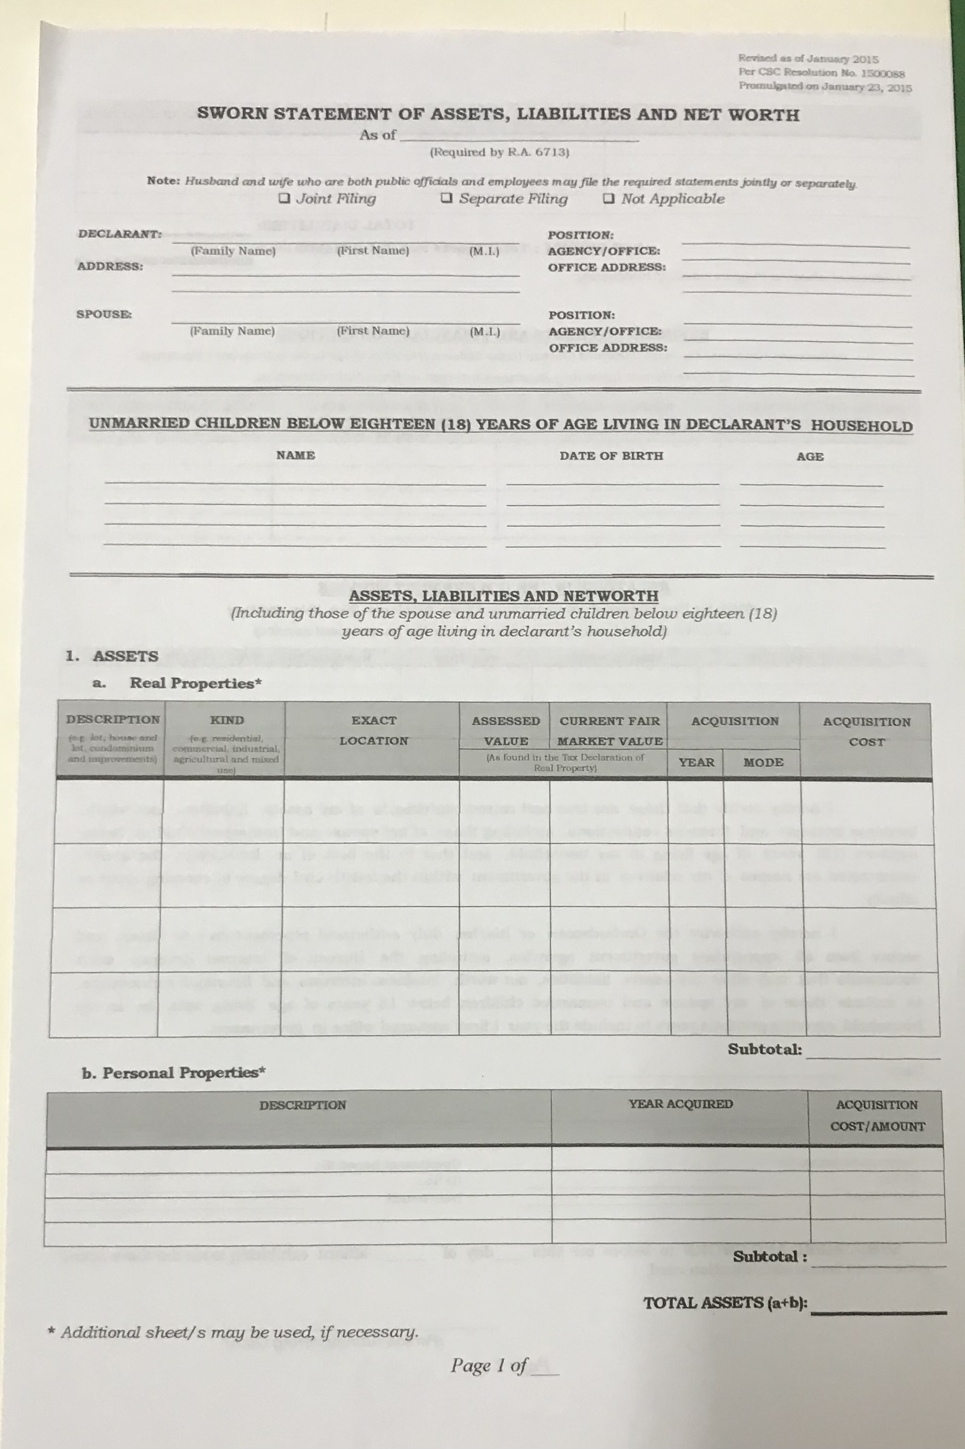
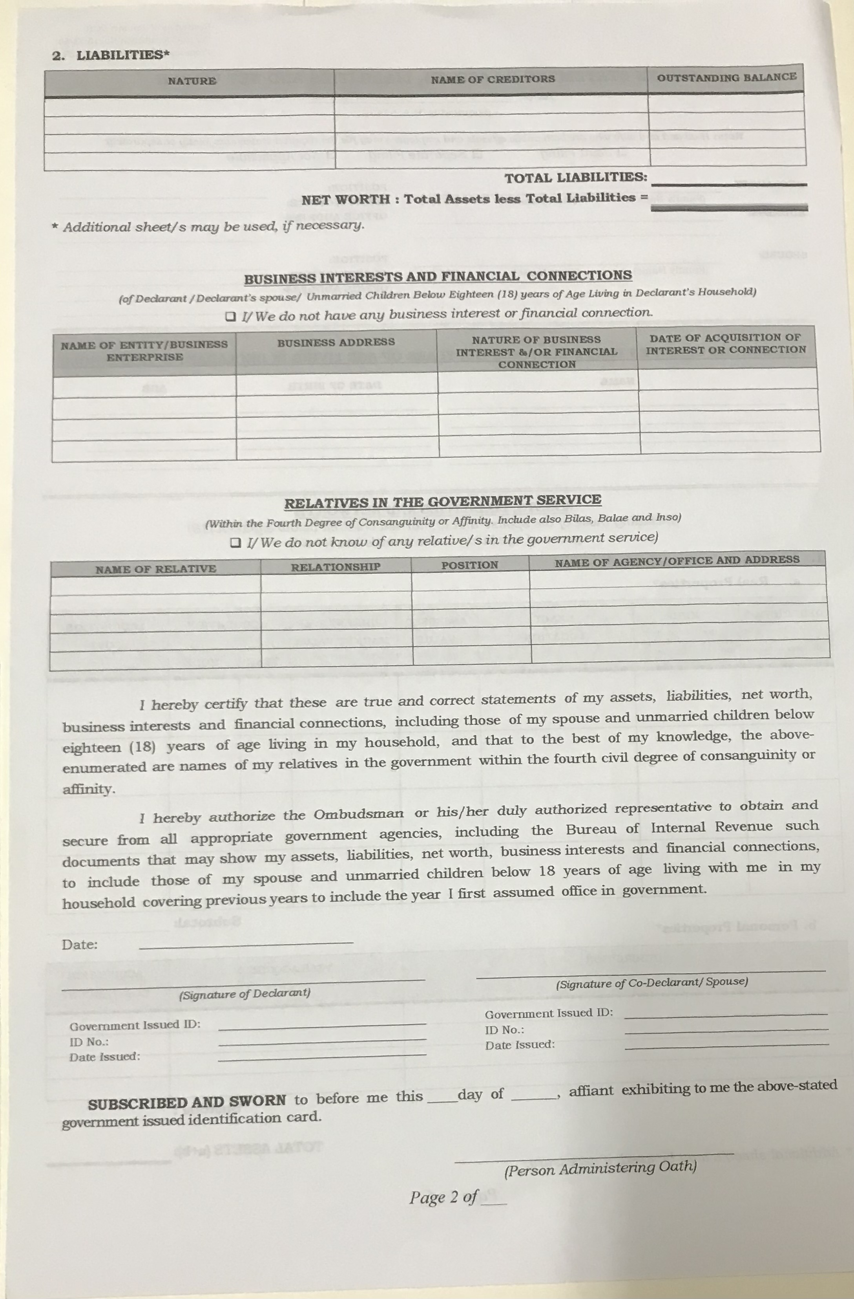
SALN FORM per CSC Resolution No. 1500088 promulgated on 23 January 2015

Slide 65
CONTENTS OF STATEMENT OF ASSETS AND LIABILITIES AND FINANCIAL DISCLOSURE
Real property, its improvements, acquisition costs, assessed value and current fair market value;
Personal property and acquisition cost;
All other assets such as investments, cash on hand or in banks, stocks, bonds, and the like;
Liabilities, and;
All business interests and financial connections.

Slide 66
NON-FILING OF SALN AFFECTS INTEGRITY
And as will be extensively demonstrated hereunder, respondent’s failure to file her SALNs and to submit the same to the JBC go into the very qualification of integrity.
In other words, when Member of the Supreme Court transgresses the SALN requirement prior to his or her appointment as such, he or she commits violation of the Constitution and belies his or her qualification to hold the office. (Republic vs. Sereno, May 11, 2018)

Slide 67
STATEMENT OF ASSETS AND LIABILITIES
AND FINANCIAL DISCLOSURE
The SALN and the Disclosure of Business Interests and Financial Connections shall be filed by:
Constitutional and national elective officials, with the national office of the Ombudsman;
Senators and Congressmen, with the Secretaries of the Senate and the House of Representatives, respectively; Justices, with the Clerk of Court of the Supreme Court; Judges, with the Court Administrator, and all national executive officials such as Members of the Cabinet, Undersecretaries and Assistant Secretaries, including the foreign service and heads of GOCCs with original charters and their subsidiaries and state colleges and universities with the Office of the President;

Slide 68
STATEMENT OF ASSETS AND LIABILITIES
AND FINANCIAL DISCLOSURE
Regional and local officials and employees, both appointive and elective, including other officials and employees of GOCCs and their subsidiaries and state colleges and universities, with the Deputy Ombudsman in their respective regions;
Officers of the armed forces from the rank of colonel or naval captain, with the Office of the President, and those below and ranks, with the Deputy Ombudsman in their respective regions; and
All other public officials and employees, defined in Republic Act No. 3019, as amended, with the Civil Service Commission.

Slide 69
IDENTIFICATION AND DISCLOSURE OF RELATIVES
Every official or employee shall identify and disclose under oath to the best of his knowledge and information, his relatives in the government, up to the fourth civil degree of relationship, either of consanguinity or affinity, including bilas (declarant’s brother-in-law’s wife or sister-in-law’s husband), inso (appellation for the wife of an elder brother or male cousin), and balae (parent of the declarant’s son-in-law or daughter-in-law), in the form, manner and frequency prescribed by the Civil Service Commission.

Slide 70
CONSANGUINITY AND AFFINITY
 | CONSANGUINITY | AFFINITY
1st degree | Parents Children | Parents-in-law
2nd degree | Grandparents Grandchildren Siblings | Grandparents-in-law Brother-in-law Sister-in-law
3rd degree | Uncle/Aunt Nephew Niece | Uncle-in-law/Aunt-in-law Nephew-in-law Niece-in-law
4th degree | 1st cousin | 1st cousin-in-law

Slide 71
ACCESSIBILITY OF DOCUMENTS
Any and all statements filed under this Act, shall be made available for inspection at reasonable hours.
Such statements shall be made available for copying or reproduction after ten (10) working days from the time they are filed as required by law unless extended for meritorious reasons.
Any person requesting a copy of a statement shall be required to pay a reasonable fee to cover the cost of reproduction and mailing of such statement, as well as the cost of certification.
Any statement filed under this Act shall be available to the public for a period of ten (10) years after receipt of the statement. After such period, the statement may be destroyed unless needed in an ongoing investigation.

Slide 72
PROHIBITED ACTS
It shall be unlawful for any person to obtain or use any statement filed under this Act for:
  Any purpose contrary to morals or public policy; or
  Any commercial purpose other than by news and communications media for dissemination to the general public.
Notes:
SEC. 8 (D), RA 6713

Slide 73
DIVESTMENT
A public official or employee shall avoid conflicts of interest at all times.
Notes:
SEC. 9, RA 6713

Slide 74
CONFLICT OF INTEREST
arises when a public official or employee is a member of a board, an officer, or a substantial stockholder of a private corporation or owner or has a substantial interest in a business, and the interest of such corporation or business, or his rights or duties therein, may be opposed to or affected by the faithful performance of official duty.
Notes:
SEC. 3 (i), RA 6713

Slide 75
SUBSTANTIAL STOCKHOLDER
Means any person who owns, directly or indirectly, shares of stock sufficient to elect a director of a corporation.
This term shall also apply to the parties to a voting trust.
Notes:
SEC. 3(f), RA 6713

Slide 76
DIVESTMENT
When conflict of interest arises, he shall resign from his position in any private business enterprise within thirty (30) days from his assumption of office and/or divest himself of his shareholdings or interest within sixty (60) days from such assumption.
The same rule shall apply where the public official or employee is a partner in a partnership.
Notes:
SEC. 9, RA 6713

Slide 77
DIVESTMENT
Divestment shall be to a person or persons other than his spouse and relatives within the fourth civil degree of consanguinity or affinity.
The requirement of divestment shall not apply to those who serve the Government in an honorary capacity nor to laborers and casual or temporary workers.
Notes:
SEC. 9, RA 6713

Slide 78
GROUNDS FOR ADMINISTRATIVE DISCIPLINARY ACTION
Unfair discrimination in rendering public service due to party affiliation or preference;
Disloyalty to the Republic of the Philippines and to the Filipino people;
Failure to act promptly on letters and request within fifteen (15) days from receipt, except as otherwise provided in these Rules.
Notes:
SEC. 1, RULE X, IRR OF RA 6713

Slide 79
GROUNDS FOR ADMINISTRATIVE DISCIPLINARY ACTION
Failure to process documents and complete action on documents and papers within a reasonable time from preparation thereof, except as otherwise provided in these Rules;
Failure to attend to anyone who wants to avail himself of the services of the office, or to act promptly and expeditiously on public personal transactions;
Notes:
SEC. 1, RULE X, IRR OF RA 6713

Slide 80
GROUNDS FOR ADMINISTRATIVE DISCIPLINARY ACTION
Failure to file a sworn statements of assets, liabilities and net worth, and disclosure of business interests and financial connections; and
Notes:
SEC. 1, RULE X, IRR OF RA 6713

Slide 81
GROUNDS FOR ADMINISTRATIVE DISCIPLINARY ACTION
Failure to resign from his position in the private business enterprise within thirty (30) days from assumption of public office when conflict of interest arises, and/or failure to divest himself of his shareholdings or interests in private business enterprise within sixty (60) days from such assumption of public office when conflict of interest arises,: Provided however, that for those who are already in the service and a conflict of interest arises, the official or employee must either resign or divest himself of said interests within the periods herein above described, reckoned from the date when the conflict of interest had arisen.
Notes:
SEC. 1, RULE X, IRR OF RA 6713

Slide 82
PENALTIES
Any public official or employee, regardless of whether or not he holds office or employment in a casual, temporary, holdover, permanent or regular capacity, committing any violation of this Act shall be punished with a fine not exceeding the equivalent of six (6) month’s salary or suspension not exceeding one (1) year, or removal depending on the gravity of the offense after due notice and hearing by the appropriate body or agency.
If the violation is punishable by a heavier penalty under another law, he shall be prosecuted under the latter statute. (eg. RA 3019)

Slide 83
PENALTIES
Violations of Sections 7, 8 or 9 of this Act shall be punishable with imprisonment not exceeding five (5) years, or a fine not exceeding five thousand pesos (P5,000), or both, and, in the discretion of the court of competent jurisdiction, disqualification to hold public office.

Slide 84
PENALTIES
Any violation hereof proven in a proper administrative proceeding shall be sufficient cause for removal or dismissal of a public official or employee, even if no criminal prosecution is instituted against him.

Slide 85
PENALTIES
Private individuals who participate in conspiracy as co-principals, accomplices or accessories, with public officials or employees, in violation of this Act, shall be subject to the same penal liabilities as the public officials or employees and shall be tried jointly with them.

Slide 86
PENALTIES
The official or employee concerned may bring an action against any person who obtains or uses a report for any purpose prohibited by Section 8(D) of this Act. The Court in which such action is brought may assess against such person a penalty in any amount not to exceed twenty-five thousand pesos (P25,000.00).
If another sanction hereunder or under any other law is heavier, the latter shall apply.

Slide 87
PENALTIES
Administrative proceedings for violation of these Rules shall be in accordance with the Civil Service Law and Rules.

Slide 88
PUBLIC OFFICE IS A PUBLIC TRUST
Public office is a public trust. Public officers and employees must at all times be accountable to the people, serve them with utmost responsibility, integrity, loyalty and efficiency, and act with patriotism and justice, and lead modest lives. (Section 1, Article XI, 1987 Constitution)

